Slide 1
Operating System

Slide 2
Operating Systems
Every computer runs programs (applications) that help you do your work, like word processors and browsers.
Every computer needs software that knows the details of the particular hardware you have and can communicate with all your applications and with you. This is the Operating System.
Several kinds of OS’s – Windows 7, 8, 10, Linux, MacOS, Unix, Android
All operating systems have the important job of keeping track of your files: where they are, what’s in them, what they are named.

Slide 3
File Names and Extensions
You must adhere to file-naming conventions when saving files
Case sensitivity – upper and lower case are different
True in Linux and Unix variations, not in Windows
If “ABC” and “abc” are different names, it IS case sensitive
Maximum length (Windows 260 characters)
Spaces allowed – be careful if using multiple spaces, can you see the difference between 2 spaces and three spaces?
Digits allowed
\ / : * ? " < > | not allowed
File extensions provide clues to the file contents
OS uses extensions to know which application created the file and the internal format of the file

Slide 4
Standard Filename Extensions
Extension | Type of Document | Application
.doc or .docx | Word processing document | Microsoft Word
.xls or .xlsx | Workbook | Microsoft Excel
.ppt or .pptx | PowerPoint presentation | MS PowerPoint
.accdb | Database | Microsoft Access
.gif, .jpg, .png | Images | Windows Image Viewer
.mp4, .mp3 | Videos, audio | Windows Media
.zip | Compressed file | WinZip
.pdf | Portable Document Format | Adobe Acrobat
.htm or .html | Web page | Hypertext Markup Language

Slide 5
How to Make Extensions Visible in Windows
Windows default is NOT to show the common extensions of filenames but we want to SEE them!
Open a Windows Explorer window
Choose Organize tab
Choose Folder and search options
Choose View tab
UNcheck the box that says “Hide extensions for known file types”
Choose “Apply to Folders”

Slide 6
File Systems – Drives
Every computer has a file system used to keep track of the files on that machine
File systems are based on physical storage devices, known as drives
Drives can be local or remote (network or cloud)
Click on “My Computer” or “This PC” to see a list of drives (on a Windows machine)

Slide 7
File Systems – Partitions
Note that a “partition” is not a physical device, although it looks like one to the OS.
Why have a partition? At one point Windows could only handle storage devices of a certain size. If your hard drive was larger than that size, you could not access the entire device. Partitions fool the OS into thinking that one device is two (or more!) devices, each with their own letter and file system So by accessing the two devices, you could use all your storage.
You will find disks partitioned even today, when some space is used for a specific need, like a backup

Slide 8
File Management
The operating system provides an organizational structure to the computer’s data and programs
Hierarchical structure of directories:
Drives
Folders
and more Folders …
Files
Storage metaphors help you visualize and mentally organize the files on your disks and other storage devices
Notes:
An additional function of the OS is to enable file management, which entails providing organizational structure to the computer’s contents. The OS allows you to organize the contents of your computer in a hierarchical structure of directories that includes drives, folders, subfolders, and files.
.

Slide 9
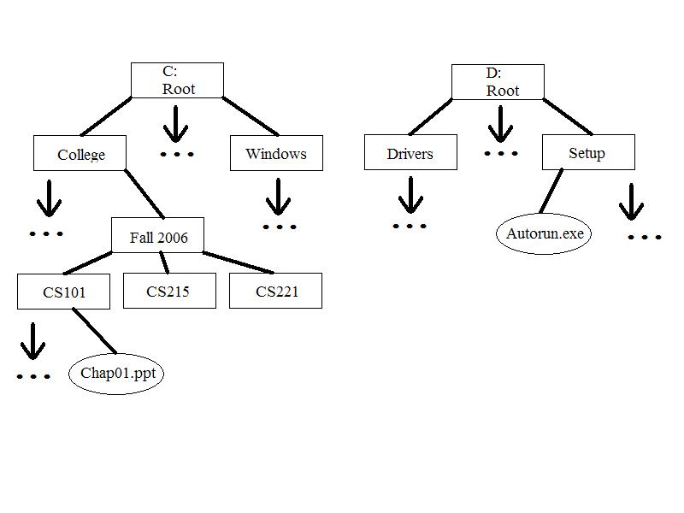
A File System Tree (2 devices)

Slide 10
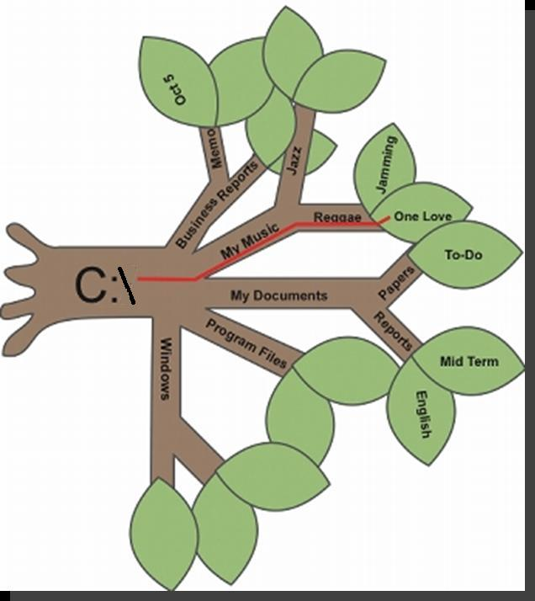
File Management Metaphors
Tree Metaphor
Root, branches, leaves
Filing Cabinet Metaphor
Drawers, Folders, Files

Slide 11
File Directories and Folders
Every storage device has a directory containing a list of its files
Root directory (like “C:\”)
Subdirectory
Depicted as folders
A computer’s file location is defined by a path
Examples: D:\ is the root of the D drive
Examples: C:\Notes\CS 101\Week 1\notes.txt
Examples: F:\1999\Music\CDs\Prince\

Slide 12
Reasons for using folders
Organization of files makes them easier to find, less stress
Easier to manipulate groups of files as one thing – moving, copying, deleting, mailing
Allows reuse of filenames, as long as the files are in different paths – you can have two “A.txt” files as long as they are in different folders
Can use different applications on the same files – create a file with Excel, zip it with Winzip, 7zip, etc. Create a video mp4 file with Zoom, play it with Windows Media

Slide 13
Units for measuring file sizes
One byte = one character, pretty small
1 Kilobyte = 1024 bytes, about a page of text
1 Megabyte = 1024 KBs, a 1000-page book
1 Gigabyte = 1024 MBs (more than 1 billion bytes), about 1000 books, a library!
1 Terabyte = 1024 GBs (more than 1 trillion bytes), over 1000 libraries
1 Petabyte = 1024 TBs (more than 1 quadrillion bytes), over 1 million libraries

Slide 14
File Management Tips
Use descriptive names
Maintain file extensions – don’t change one unless you convert the file to that type
Group similar files into a folder
Organize your folders from the top down
Consider using default folders but consider putting folders inside them – My Documents can be subdivided as you like!
Do not mix data files and program files in the same folder

Slide 15
File Management Tips
Don’t store too many files in the root directory – actually slows down the access
Follow copyright rules
Delete or archive files you no longer need
Be aware of storage locations!
You will not be able to submit your lab test work if you do not know where you put your files!
Make Backups!

Slide 16
Zipping a file or files
Files can be compressed by removing the redundancies in them
Zip also archives them - turns several files into one file, easier to move, copy, upload, etc.
Created by Phil Katz in 1989
In Windows, select the files to zip
Right click on one of them
Choose "Send to compressed folder"
You may need to rename the file afterward

Slide 17
Shortcuts
Can create another icon which points to a file or folder or program
Double clicking on it is equivalent to double clicking on what it points to
But be careful! The shortcut is NOT a copy of the file! If the original file is moved or deleted, the shortcut does not work
When submitting lab tests, be careful of this! Do not send your TA JUST a bunch of shortcuts!

